Slide 1


Emergency Response Training
St. Clair College Emergency Response Training for ALL Workers
April 2026 - April 2027
Please Note: Updates will be scheduled as Legislation or Organizational changes occur
Last Update: April 15, 2026

Slide 2

ADDITIONAL INFO LINK
Emergencies – Click the sound icon below to hear the words.
The College has an emergency communication system called Alertus and the mobile app, AlertAware. In an emergency situation, Security will make every attempt to send a message via Alertus and AlertAware to inform the College Community of the situation and provide immediate and follow up information.
Alertus/AlertAware messaging will be sent to all College computers, computer screens in hallways and to your cell phone if you have subscribed (see next slide for instructions)
Messaging will also be sent out via the Voice Communication system where available.
Official College messaging will always be posted on the College web page.

Slide 3

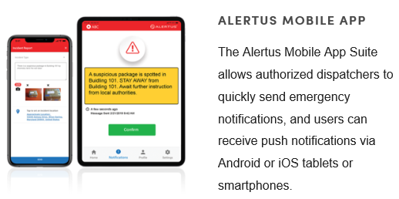
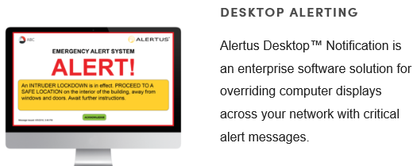
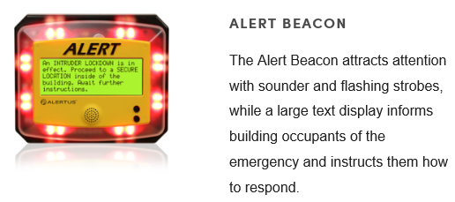

Please click on the image for additional information

Slide 4
ADDITIONAL INFO LINK
Emergencies
Reporting Emergencies
Report Emergencies using College internal phones as follows:
South and Downtown Campus – 4911
Chatham Campus – 3911
Other locations – 911 and follow up with South Campus Security at 519-972-2741
Report using Alertus/AlertAware
You can report an emergency or any Security situation to Security by way of Alertus. Staff have panic buttons on their computers that they can use to alert Security via the Alertus Desktop Notifier.
Staff and students who subscribe to the AlertAware App can also use the App to alert Security to a situation
Always identify your campus, room/location and the situation details.

Slide 5
ADDITIONAL INFO LINK
Emergencies
Fire Emergencies
Buildings with one (1) stage alarms – Everyone must evacuate upon hearing the fire alarm.
Chatham Campus Main Building
Chatham National Powerline Training Centre
Chatham HealthPlex
South Campus – CCIP and Truck and Coach Buildings
Employees with sweeping duties will immediately carry out their duties as trained
Assemble in Evacuation Collection Areas

Slide 6
ADDITIONAL INFO LINK
Emergencies
Fire Emergencies
Buildings with two (2) stage alarms
South Campus – Main Building, Automotive, Powerhouse, G Building, FCEM, CAHS, SportsPlex
St. Clair College Center for the Arts
Upon hearing a first stage alarm (slow bells and voice communication will guide you), listen for additional information and be prepared to evacuate
Upon hearing a second stage alarm, everyone must evacuate
Employees with sweeping duties will prepare to carry out their duties as trained when they hear the first stage alarm and begin to carry out duties upon hearing the second stage alarm
Assemble in Evacuation Collection Areas

Slide 7
ADDITIONAL INFO LINK
Emergencies
Fire Emergencies
South Campus Main Building
Important Notes: The main building on South Campus is divided up into fire zones. Zones are noted by colour and are identified by signage throughout the building. When one zone goes into first stage alarm, the others do not. Once that zone goes into second stage alarm (evacuation), adjacent zones go into first stage. This cascades to each zone. The College Emergency Response team is activated on first stage and if a false alarm, can stop the cascading and need for evacuation.
St. Clair College Centre for the Arts
Important Notes: The basement extends under the adjacent hotel. Once you pass through the double doors, you are under the hotel’s fire alarm system and need to follow the directions as posted. Move into the College section of the basement or exit through the emergency exits

Slide 8
ADDITIONAL INFO LINK
Emergencies
Fire Emergencies
College Community Members with Mobility Concerns
The College has identified in several stairwells, which are marked, an area of safety for you to assemble if not on the first floor. Emergency Wardens (Sweepers), the College emergency response team and emergency responders will be checking each area and assist in the evacuation as necessary. Please connect with Security to develop an emergency evacuation plan specific to you.

Slide 9
ADDITIONAL INFO LINK
Emergencies
Medical Emergencies
Call the campus emergency line to get immediate medical help
Windsor Campuses – 4911
Chatham Campus – 3911
Security and where and if possible, the Campus Health Nurse, will respond
An ambulance will be called by Security. If you call an ambulance, call Security and tell them
If critical injury results, secure the scene. No further work in the area is permitted. Security will initiate the Critical Injury Protocol
Complete an Incident and Investigation Form

Slide 10
ADDITIONAL INFO LINK
Emergencies
Active Attacker On Campus
If an announcement or Alertus/AlertAware message comes over that indicates an Active Attacker is on campus in a certain area, it means that an individual has been spotted in the building (or on site) with a weapon
Your response depends on your location and may include:
Run – Hide – Fight
Assess the situation as you know it (be attentive to your surroundings and what you are hearing)
If you are able to safely leave the building, do so
If you need to hide, secure/barricade the room that you are in (or get into the closest room), shut off the lights, silence your mobile device and stay out of sight
If in the immediate area of the shooter, do what you can to fight to survive

Slide 11
ADDITIONAL INFO LINK
Emergencies
Bomb Threat
If a bomb threat is issued to the College and you receive the call or message, collect as much information as you can, remaining calm, and immediately call Security (4911 or 3911)
Bomb Threat checklist is part of this procedure and should be reviewed by those most likely to answer the call
Bomb threats will not be announced to the College. An immediate evacuation may take place. The Police will be called in to work with the College to assess the risk and determine appropriate safe actions required

Slide 12
ADDITIONAL INFO LINK
Emergencies
Severe Weather
Severe weather can occur at any time of the day
If a tornado warning is issued with an urgency to take cover, an announcement will be made that there is a tornado warning and cover shall be taken immediately
If able, move to the basement of the building or into an interior room without exterior doors or windows
If outside, move to a low lying area if able and lie face down and cover your head

Slide 13
ADDITIONAL INFO LINK
Emergencies
Severe Weather
All other weather conditions resulting in required action by employees may be announced by one or any combination of the following:
AlertAware Mobile App and Alertus Desktop Applications
Email
College Website (Public)
Telemessaging
Campus public announcement system
Local radios stations, including:
AM 800 CKLW (Windsor)
CKSY/CFCO (Chatham)
CBC (Windsor)
CHYR (Leamington)
The Rock (Windsor)

Slide 14
ADDITIONAL INFO LINK
Emergencies
Hazardous Materials Release
If you spill or encounter a spill of a hazardous or unknown material, call Security immediately
Indicate if there are any injuries associated with the spill and the location of the spill
Indicate the material involved, if known, and approximate quantity
Remove yourself and others from the area
Security will initiate Facilities and Occupational Health and Safety to review the situation and call for spill clean up and the local police as necessary

Slide 15
ADDITIONAL INFO LINK
Emergencies
Other Emergencies
Power outage
Suspected gas leak
Loss of water or heat
Theft in process
Violence
Your first contact for any emergency situation is the campus emergency line
Windsor Campuses 4911
Chatham Campus 3911
Security will initiate the proper response by calling the appropriate emergency response personnel to the scene.
Whenever possible, Security will send out messaging through Alertus and the Voice Communication system where available.

Slide 16
ADDITIONAL INFO LINK
Emergencies
All Classrooms have Emergency Postings (see next slide) with Emergency Procedures
Faculty – please review these postings at the start of each semester with all students
Managers – please review with new employees
All Employees – Know and understand what is required of you during an emergency situation. Know where your closest two emergency exits are at any time. If questions remain, ask. Members of the Emergency Response Team are available to answer questions or provide additional training.
Core Emergency Response Team
Security
Manager Health, Safety and Security
AVP, Safety, Security and Facilities Management
Manager, Facilities Maintenance and Energy Management
Manger, Construction and Engineering Services
General Manager, St. Clair College Centre for the Arts
Manager Student Services, Chatham Campus

Slide 17
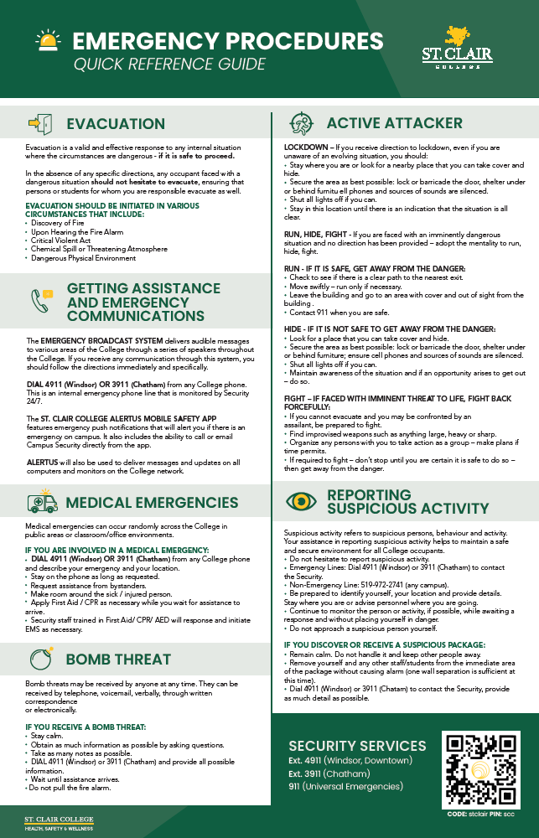
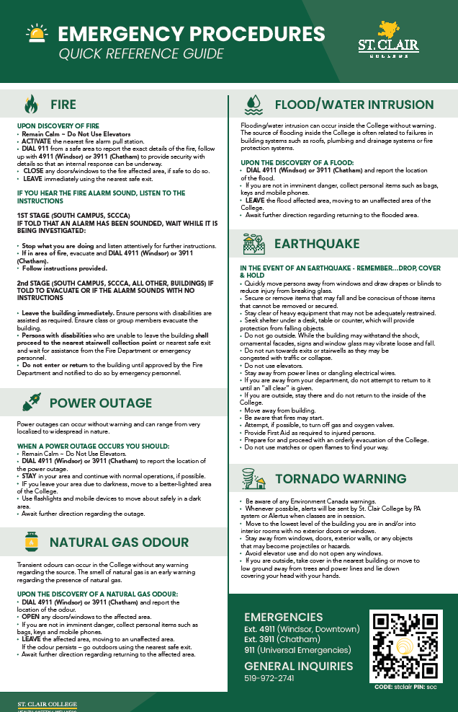
St. Clair College
EMERGENCY RESPONSE PLAN LINK
Please click on the images to download and print for your office

