Slide 1


Emergency Response Training
St. Clair College Emergency Response Training for ALL Workers
May 2022 - April 2025
Please Note: Updates will be scheduled as Legislation or Organizational changes occur
Last Update: July 11, 2022

Slide 2

ADDITIONAL INFO LINK
Emergencies
The College has an emergency communication system called Alertus. In an emergency situation, Security will make every attempt to send a message via Alertus to inform the College Community of the situation and provide immediate and follow up information.
Alertus messaging will be sent to all College computers, computer screens in hallways and to your cell phone if you have subscribed (see next slide for instructions)
Messaging will also be sent out via the Voice Communication system where available.
Official College messaging will always be posted on the College web page.

Slide 3

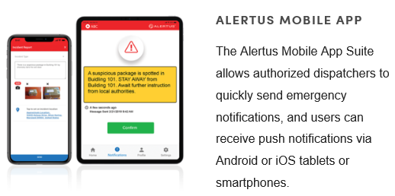
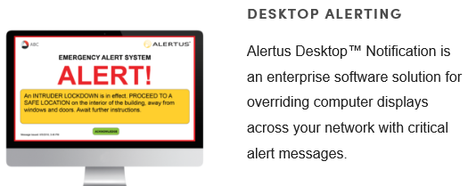
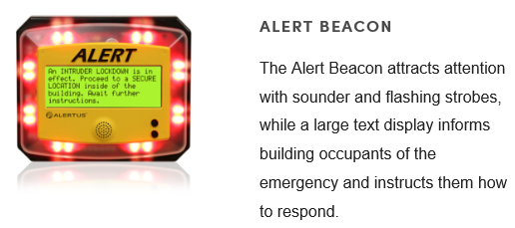

Please click on the image for additional information

Slide 4
ADDITIONAL INFO LINK
Emergencies
Reporting Emergencies
Report Emergencies using College internal phones as follows:
  South and Downtown Campus – 4911
  Chatham Campus – 3911
  Other locations – 911 and follow up with South Campus Security at 519-972-2741
Report using Alertus
  You can report an emergency or any Security situation to Security by way of Alertus. Staff have panic buttons on their computers that they can use to alert Security
  Staff and students who subscribe to the Alertus App can also use the App to alert Security to a situation
Always identify your campus, room/location and the situation details.

Slide 5
ADDITIONAL INFO LINK
Emergencies
Fire Emergencies
  Buildings with one (1) stage alarms – Everyone must evacuate upon hearing the fire alarm.
    Chatham Campus Main Building
    Chatham National Powerline Training Centre
    Chatham HealthPlex
    MediaPlex
    Zekelman School of Business
    St. Clair College TD Student Success Center
    South Campus – CCIP and Truck and Coach Buildings
  Employees with sweeping duties will immediately carry out their duties as trained
  Assemble in Evacuation Collection Areas

Slide 6
ADDITIONAL INFO LINK
Emergencies
Fire Emergencies
  Buildings with two (2) stage alarms
      South Campus – Main Building, Automotive, Powerhouse, G Building, FCEM, CAHS, SportsPlex
      St. Clair College Center for the Arts
  Upon hearing a first stage alarm (slow bells and voice communication will guide you), listen for additional information and be prepared to evacuate
  Upon hearing a second stage alarm, everyone must evacuate
  Employees with sweeping duties will prepare to carry out their duties as trained when they hear the first stage alarm and begin to carry out duties upon hearing the second stage alarm
  Assemble in Evacuation Collection Areas

Slide 7
ADDITIONAL INFO LINK
Emergencies
Fire Emergencies
South Campus Main Building
Important Notes: The main building on South Campus is divided up into fire zones. Zones are noted by colour and are identified by signage throughout the building. When one zone goes into first stage alarm, the others do not. Once that zone goes into second stage alarm (evacuation), adjacent zones go into first stage. This cascades to each zone. The College Emergency Response team is activated on first stage and if a false alarm, can stop the cascading and need for evacuation.
St. Clair College Centre for the Arts
Important Notes: The basement extends under the adjacent hotel. Once you pass through the double doors, you are under the hotel’s fire alarm system and need to follow the directions as posted. Move into the College section of the basement or exit through the emergency exits

Slide 8
ADDITIONAL INFO LINK
Emergencies
Fire Emergencies
College Community Members with Mobility Concerns
  The College has identified in several stairwells, which are marked, an area of safety for you to assemble if not on the first floor. Emergency Wardens (Sweepers), the College emergency response team and emergency responders will be checking each area and assist in the evacuation as necessary. Please connect with Security to develop an emergency evacuation plan specific to you.

Slide 9
ADDITIONAL INFO LINK
Emergencies
Medical Emergencies
  Call the campus emergency line to get immediate medical help
    Windsor Campuses – 4911
    Chatham Campus – 3911
  Security and where and if possible, the Campus Health Nurse, will respond
  An ambulance will be called by Security. If you call an ambulance, call Security and tell them
  If critical injury results, secure the scene. No further work in the area is permitted. Security will initiate the Critical Injury Protocol
  Complete an Incident and Investigation Form

Slide 10
ADDITIONAL INFO LINK
Emergencies
Active Attacker On Campus
  If an announcement or Alertus message comes over that indicates an Active Attacker is on campus in a certain area, it means that an individual has been spotted in the building (or on site) with a weapon
  Your response depends on your location and may include:
  Run – Hide – Fight
    Assess the situation as you know it (be attentive to your surroundings and what you are hearing)
    If you are able to safely leave the building, do so
    If you need to hide, secure/barricade the room that you are in (or get into the closest room), shut off the lights, silence your mobile device and stay out of sight
    If in the immediate area of the shooter, do what you can to fight to survive

Slide 11
ADDITIONAL INFO LINK
Emergencies
Bomb Threat
  If a bomb threat is issued to the College and you receive the call or message, collect as much information as you can, remaining calm, and immediately call Security (4911 or 3911)
    Bomb Threat checklist is part of this procedure and should be reviewed by those most likely to answer the call
  Bomb threats will not be announced to the College. An immediate evacuation may take place. The Police will be called in to work with the College to assess the risk and determine appropriate safe actions required

Slide 12
ADDITIONAL INFO LINK
Emergencies
Severe Weather
  Severe weather can occur at any time of the day
  If a tornado warning is issued with an urgency to take cover, an announcement will be made that there is a tornado warning and cover shall be taken immediately
  If able, move to the basement of the building or into an interior room without exterior doors or windows
  If outside, move to a low lying area if able and lie face down and cover your head

Slide 13
ADDITIONAL INFO LINK
Emergencies
Severe Weather
  All other weather conditions resulting in required action by employees may be announced by one or any combination of the following:
    Alertus Mobile and Desktop Applications
    Email
    College Website (Public)
    Telemessaging
    Campus public announcement system
    Local radios stations, including:
        AM 800 CKLW (Windsor)
        CKSY/CFCO (Chatham)
        CBC (Windsor)
        CHYR (Leamington)
        COOL FM 100.7(Windsor)
        Country 95.9 FM

Slide 14
ADDITIONAL INFO LINK
Emergencies
Hazardous Materials Release
  If you spill or encounter a spill of a hazardous or unknown material, call Security immediately
    Indicate if there are any injuries associated with the spill and the location of the spill
    Indicate the material involved, if known, and approximate quantity
    Remove yourself and others from the area
  Security will initiate Facilities and Occupational Health and Safety to review the situation and call for spill clean up and the local police as necessary

Slide 15
ADDITIONAL INFO LINK
Emergencies
Other Emergencies
  Power outage
  Suspected gas leak
  Loss of water or heat
  Theft in process
  Violence
  Your first contact for any emergency situation is the campus emergency line
    Windsor Campuses 4911
    Chatham Campus 3911
  Security will initiate the proper response by calling the appropriate emergency response personnel to the scene.
  Whenever possible, Security will send out messaging through Alertus and the Voice Communication system where available.

Slide 16
ADDITIONAL INFO LINK
Emergencies
All Classrooms have Emergency Postings (see next slide) with Emergency Procedures
Faculty – please review these postings at the start of each semester with all students
Managers – please review with new employees
All Employees – Know and understand what is required of you during an emergency situation. Know where your closest two emergency exits are at any time. If questions remain, ask. Members of the Emergency Response Team are available to answer questions or provide additional training.
Core Emergency Response Team
  Security
  AVP, Safety, Security and Facilities Management
  Manager, Facilities Maintenance and Energy Management
  Manger, Construction and Engineering Services
  Manager Health, Safety and Wellness
  General Manager, St. Clair College Centre for the Arts
  Manager Student Services, Chatham Campus

Slide 17
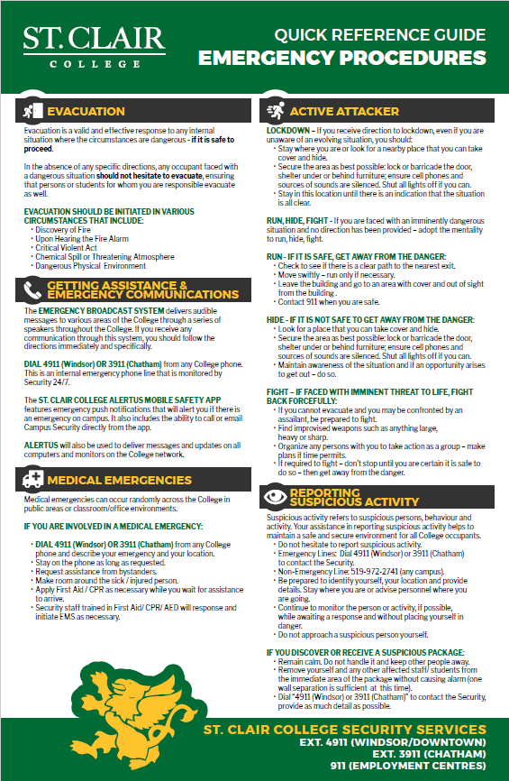
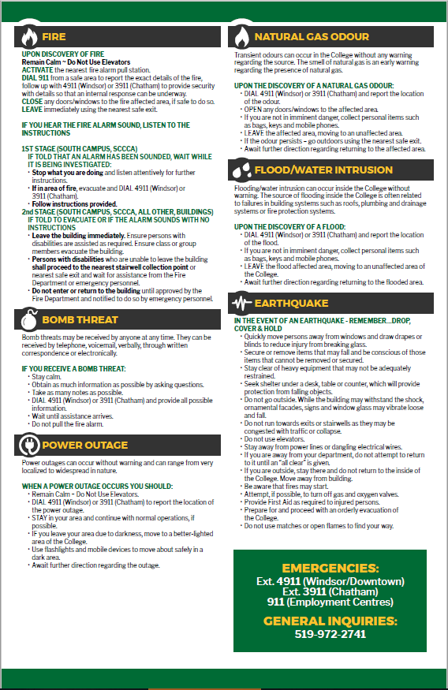
St. Clair College
EMERGENCY RESPONSE PLAN LINK
Please click on the images to download and print for your office

